Slide 1
DWDM Mini Project
Dhruv Mittal 1032180428
Isha Singh 1032180774
Shriya Upasani 1032180828
Jaya Shivnani 1032181096

Slide 2
Problem statement
To perform data mining tasks on a given dataset in order to automate the prediction of Chocolate Rating using different classification algorithms.
To compare the performance through the accuracy of the predictions.
To perform data visualization using Python and Seaborn

Slide 3
Objectives
Preprocessing of dataset to get rid of unnecessary data and prepare the dataset for classification.
Visualization of the data we have.
Classifying cocoa bean based on its rating.

Slide 4
Tools used:
Dataset Description:
Jupyter Notebook
Seaborn (visualisation package)
Dataset Name: Flavors of Cacao
Source: Kaggle

Slide 5
Attribute Information:
Company Name
Species (Specific bean origin)
REF
Review Date
Cocoa Percent
Company Location
Rating
Bean Type
Country

Slide 6
Data Preprocessing
Dataset was cleaned, unnecessary values were removed.
Checked for missing values
Renaming columns for better format and simplicity

Slide 7
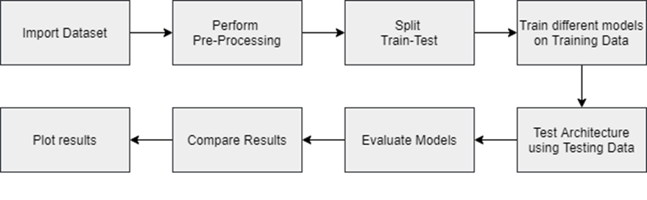
Architecture:

Slide 8
Data mining tasks performed:
Normalizing value in percentage to decimal for better understanding
Visualization of data:
Representing data in graphical format using histogram.
Data Splitting:
Partitioning data into portions in order to evaluate performance.

Slide 9
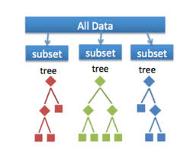
Techniques used for Data Mining:
Algorithms used for classification were:
Random Forrest Classfier

Slide 10
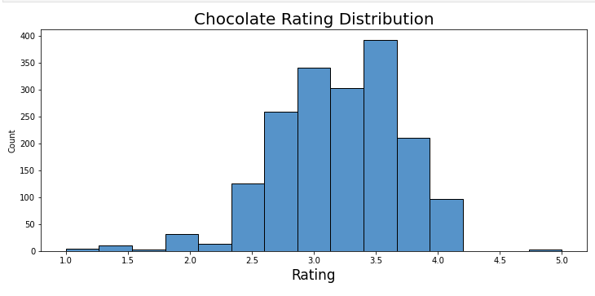
Visualization Performed:

Slide 11
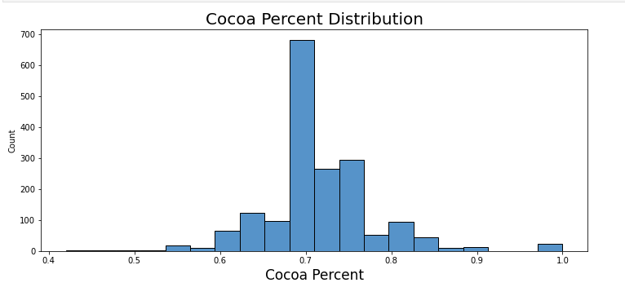

Slide 12
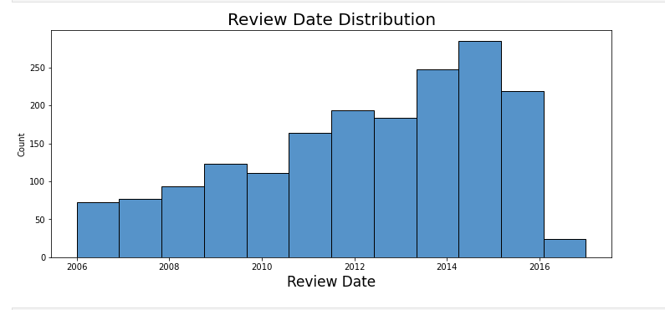

Slide 13
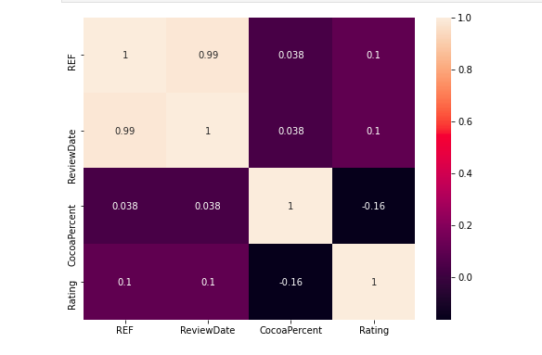

Slide 14
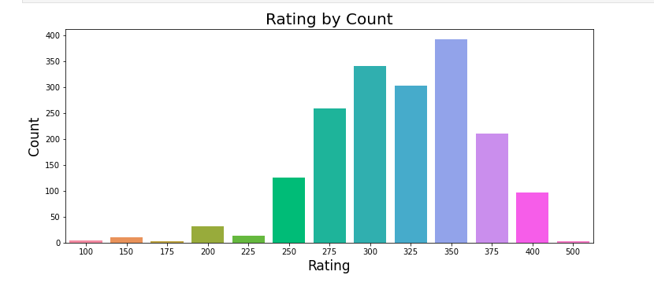
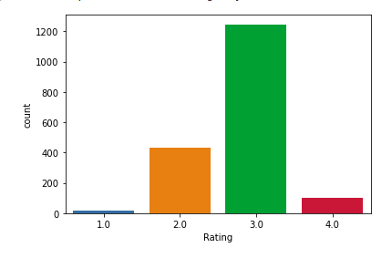

Slide 15
Conclusion
Thus, we have performed data mining processes such as preprocessing, data classification, data splitting, and visualisation of data. Using data classification we have implemented a model which can predict the rating of chocolate bars with a minimum accuracy of 25% which can further be improved by using random forest classifier to a good 75%

Slide 16
Thank You!

